Slide 1
Computer scıence and computatıonal thınkıng
BTO1111 Information Technology in Education
Week 4
Dr. M. Fatih ERKOÇ

Slide 2
Computer Science Education in 1980’s
Seymour Papert’s dream…
Children would program computers to;
Control robots,
Compose music,
Design games,
Develop simulations,
Perform many other creative activities.
In the 1980s, there was initial enthusiasm for teaching computer programming (or coding) to children.
But the enthusiasm did not last.
Notes:
Seymour Papert’s Book: MINDSTORMS Children, Computers, and Powerful Ideas :The Gears of My Childhood

Slide 3
Computer Science Education in 2000’s
Seymour Papert’s dreams have become a reality…
Millions of children around the world interact with computation in a wide variety of forms;
Electronic toys,
Mobile phones,
Game machines,
Laptops, and tablets.
They use computational devices to engage in a diverse range of activities, such as playing games, chatting with friends, exploring virtual worlds, and searching for information online.

Slide 4
What was the real dream of Papert?

Slide 5
Papert’s dream is…
Papert envisioned a world in which children would not only interact with premade computer applications but would;
Design,
Create,
Program with computational media.
In the creative process, childeren would;
Learn important problem-solving skills
Project-design strategies.

Slide 6
Popularity of Programming…
In the past few years, coding has suddenly become fashionable again, with numerous websites and organizations encouraging and supporting people to learn to code.
One of the most important initiatives is Lifelong Kindergarten research group at the MIT Media Lab which was develop Scratch programming language and online community to enable young people to program and share interactive stories and games.

Slide 7
Maker Movement vs. Coder Movement (Coding Revival)
Maker movement focuses on new ways for people to;
Build,
Create,
Personalize,
Customize physical things.
Coder movement is the same for digital things.

Slide 8
Definition of Computer Science
Association for Computer Machinery – ACM defines computer science as is neither programming nor computer literacy.
Rather, it is “the study of computers and algorithmic processes including their principles, their hardware and software design, their applications, and their impact on society”

Slide 9
Computer Science includes…
Computer Science
Programming
Hardware Design
Networks
Graphics
Databases and Information Retrieval
Computer Security
Software Design
Programming Languages and Paradigms
Logic
Translation Between Levels of Abstraction
Artificial Intelligence
The Limits of Computations
Applications in Information Technology and Information Systems
Social Issues

Slide 10
Computational Thinking
According to Jeannette Wing, computational thinking represents a universally applicable attitude and skill set everyone, not just computer scientists, would be eager to learn and use.
Computational thinking involves solving problems, designing systems, and understanding human behavior, by drawing on the concepts fundamental to computer science.

Slide 11

Computational Thinking

Slide 12
What is and isn’t Computational Thinking?
Conceptualizing, not programming. Thinking like a computer scientist means more than being able to program a computer. It requires thinking at multiple levels of abstraction.
Fundamental, not rote skill. A fundamental skill is something every human being must know to function in modern society.
A way that humans, not computers, think. Computational thinking is a way humans solve problems; it is not trying to get humans to think like computers.
Complements and combines mathematical and engineering thinking.
Ideas, not artifacts.
For everyone, everywhere.
Notes:
Ideas, not artifacts. It’s not just the software and hardware artifacts we produce that will be physically present everywhere and touch our lives all the time, it will be the computational concepts we use to approach and solve problems, manage our daily lives, and communicate and interact with other people.

Slide 13
The Key Skills of Computational Thinking
Four key skill sets of computational thinking;
Decomposing,
Pattern Recognition,
Abstraction,
Algorithmic thinking.

Slide 14

The Key Skills of Computational Thinking

Slide 15
Approaches for K12 Classrooms
Technology – Free (Unplugged Computer Science) Computational Thinking;
compilation of free activities to introduce students of all ages to the central concepts in computer science without the use of a computer.
Programming Games or Robots;
use of games and robots to introduce computer science and computational thinking concepts.
Microsoft Kodu Game Lab
iDreams Game Design
TangibleK Robotics
Modular Robotics
Block Based Programming Languages
These environments support novice programmers by allowing the direct manipulation of objects or through visualizations to support learning.
Scratch
Blockly

Slide 16
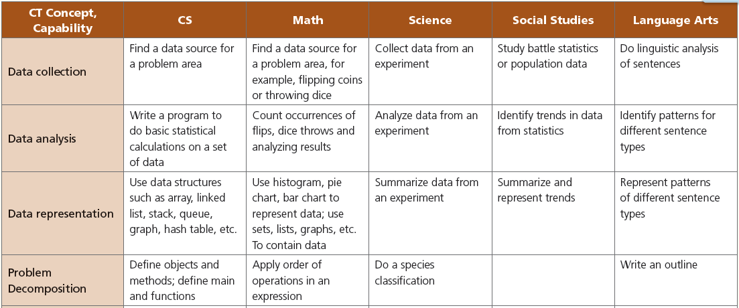
Integrating Computational Thinking with Other Disciplines

Slide 17
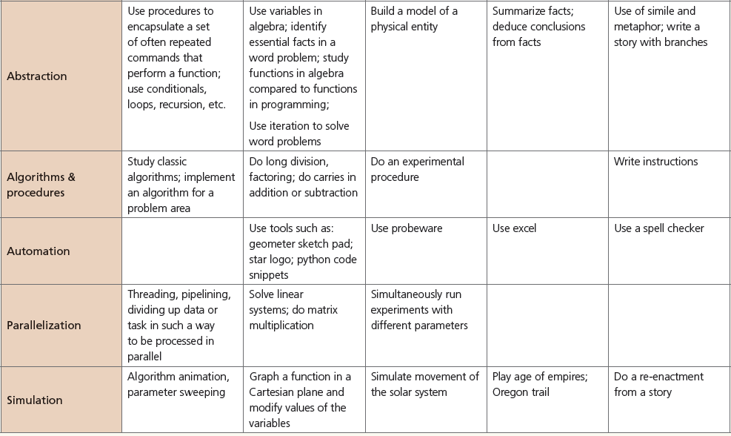
Integrating Computational Thinking with Other Disciplines

Slide 18
Assignment
First of all, identify a complex problem like in the video which you are watching (car tire). Solve this problem step by step using four key skills of computational thinking.

